Slide 1
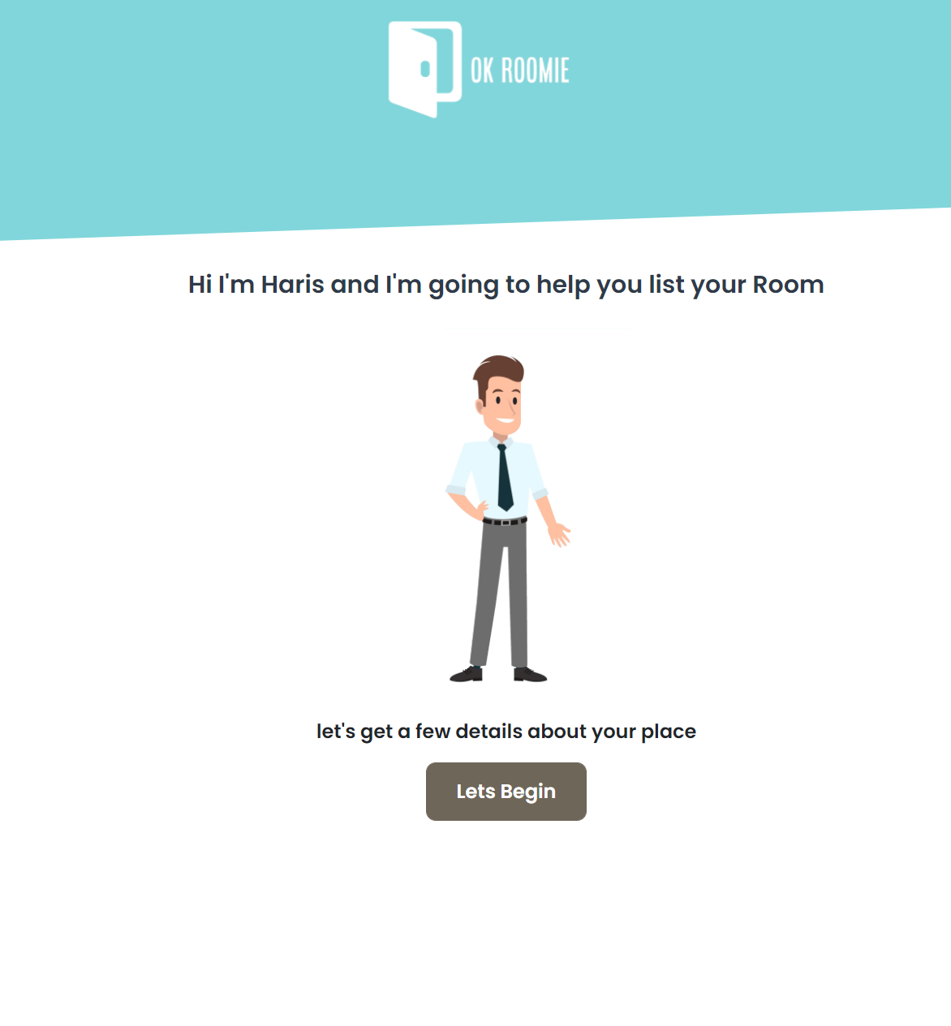

Slide 2
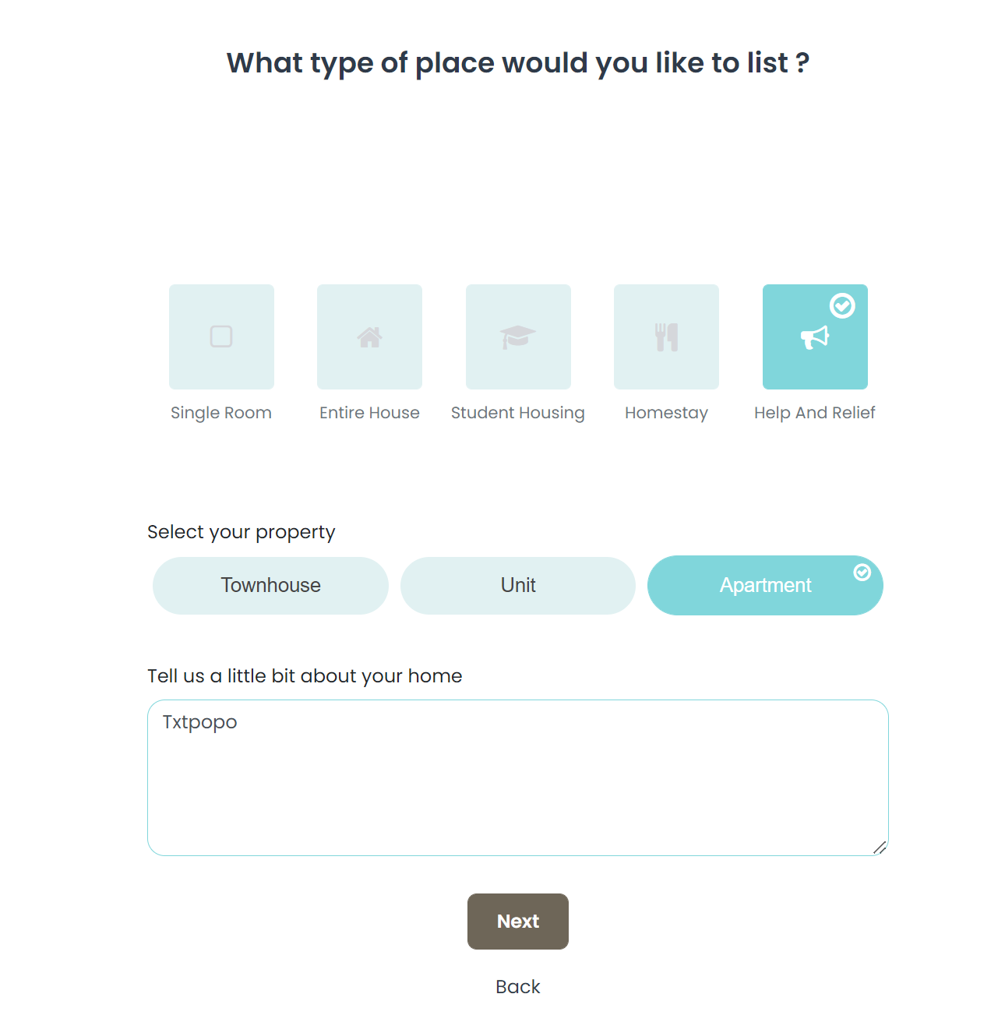
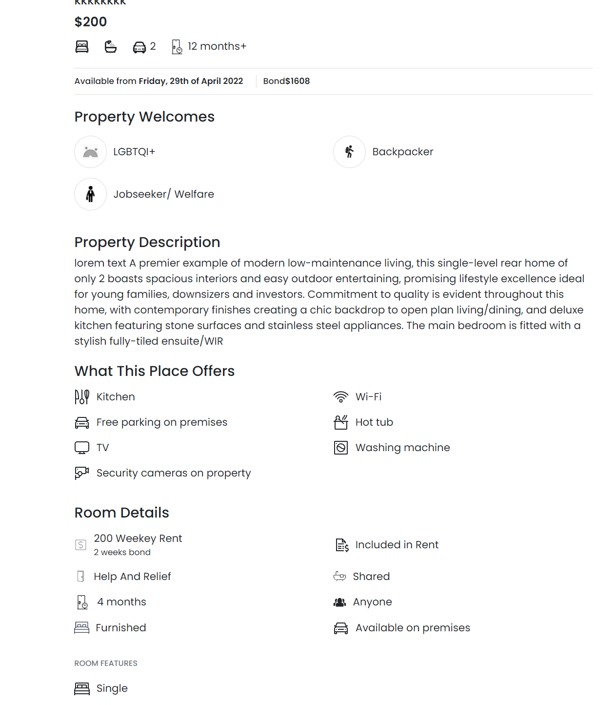
Property description
In a Apartment – N*

Slide 3
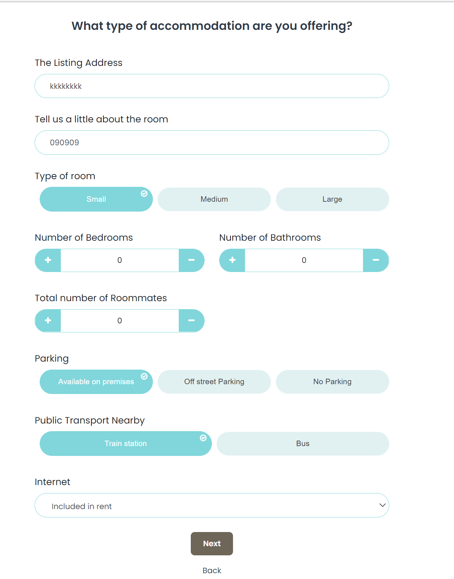
Address
Roommates
Public Transport : Train
Remove
<Type of room> Room
Example : Small Room
Address

Slide 4
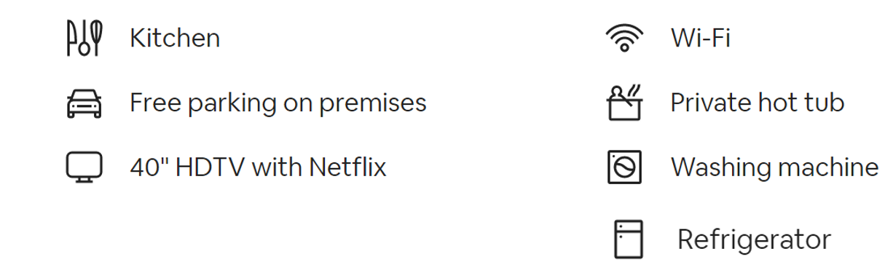


YEH FLOW INCLUDE KARNA HOGA
What this place offers :
Dining table
Balcony/ Outdoor area
BBQ Area
Big Yard space
Gym Area
Air conditioner
Heating

Slide 5
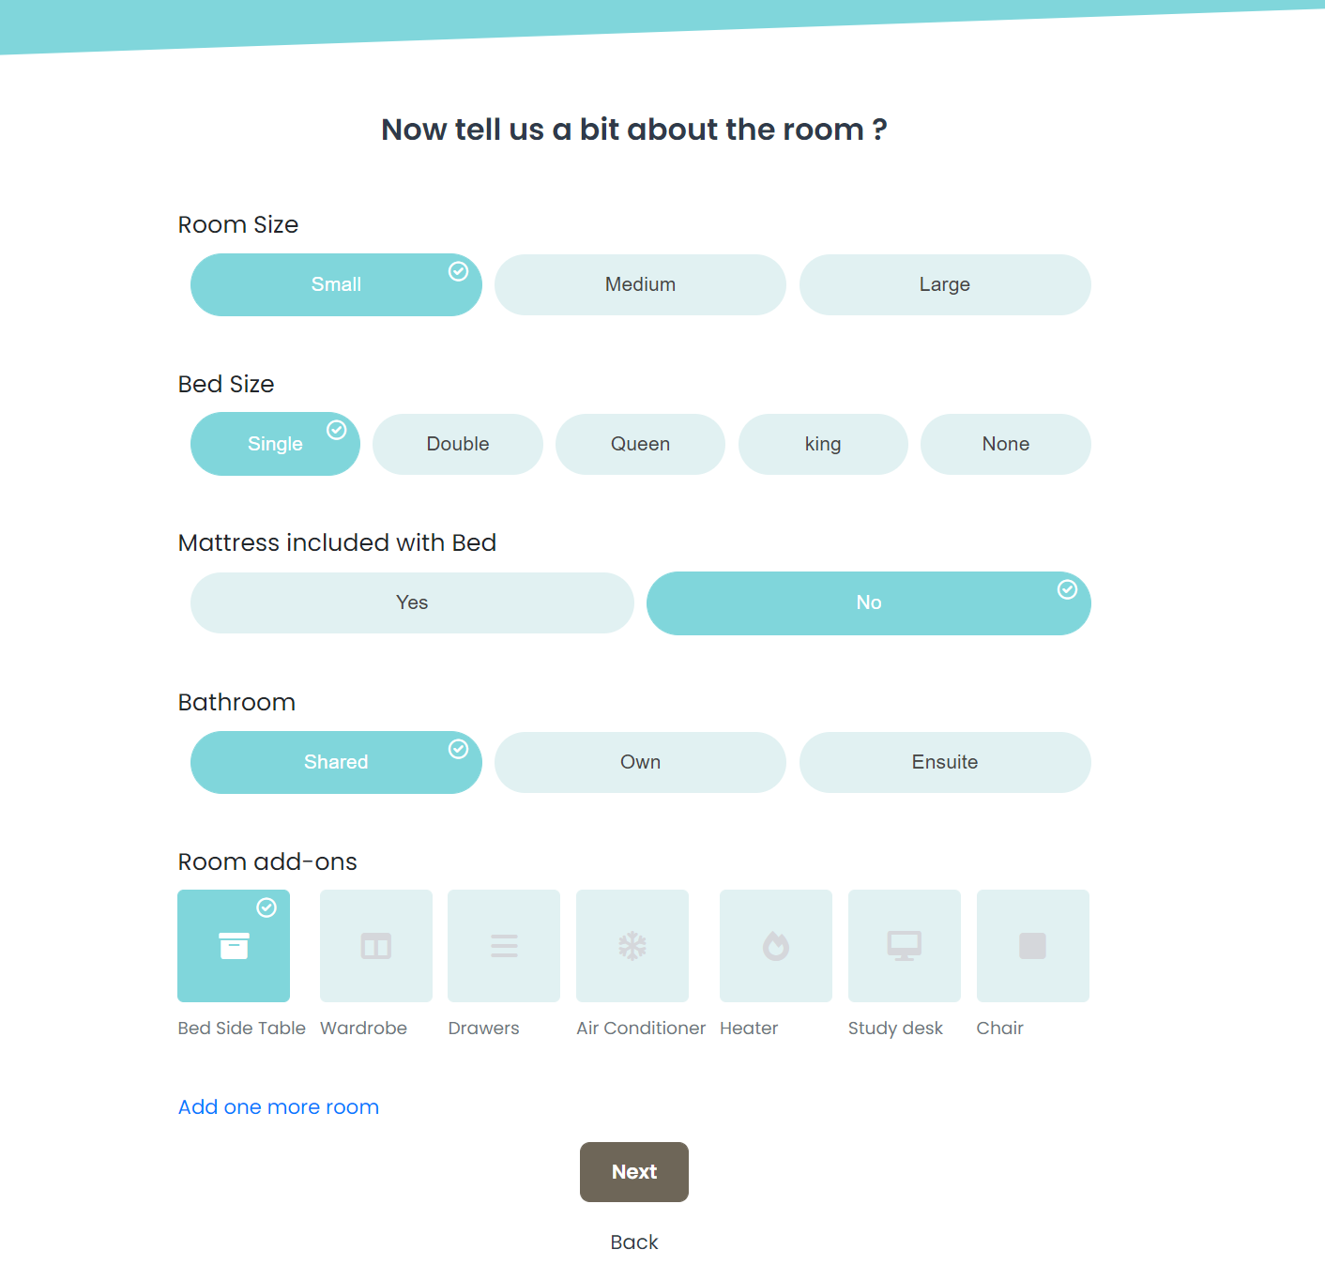
Remove kar do
Remove kar do
What’s included in this room

Slide 6
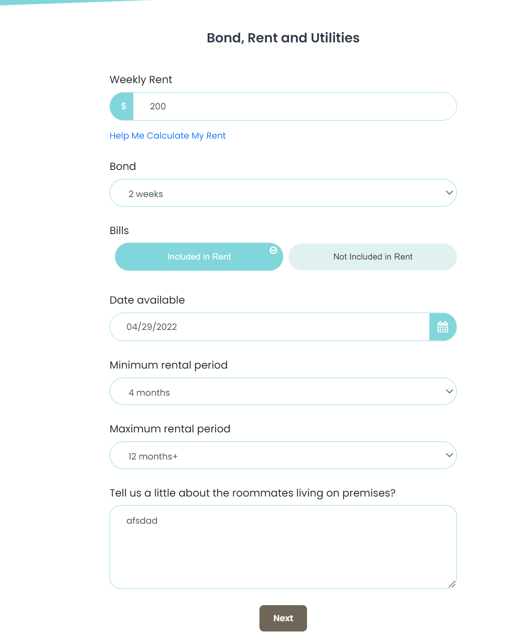
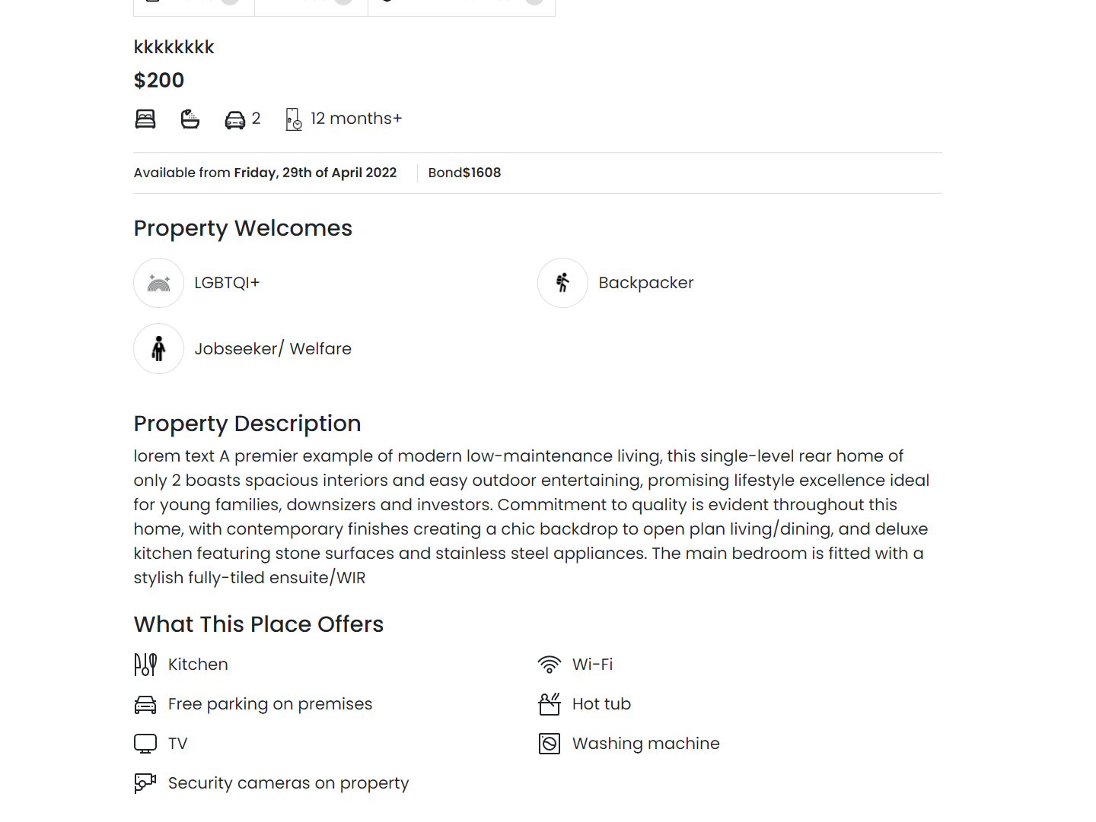
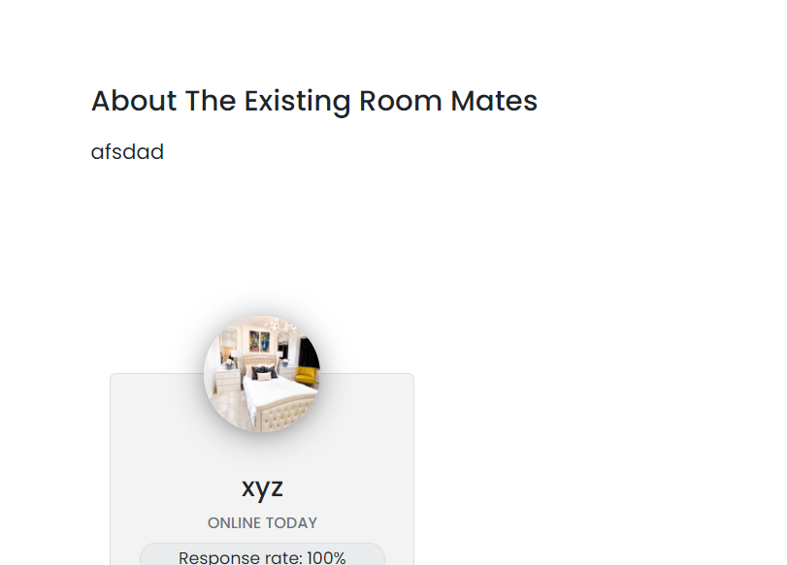
Bills are
Big Yard space

Slide 7
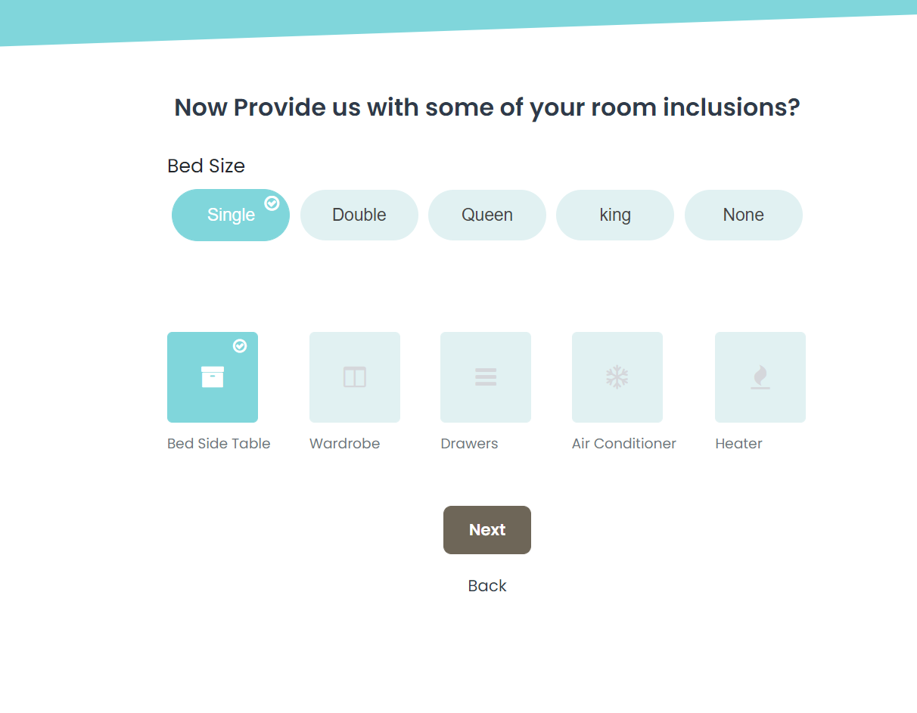
Remove this – YEH SARA SECTION NIKAL DO

Slide 8
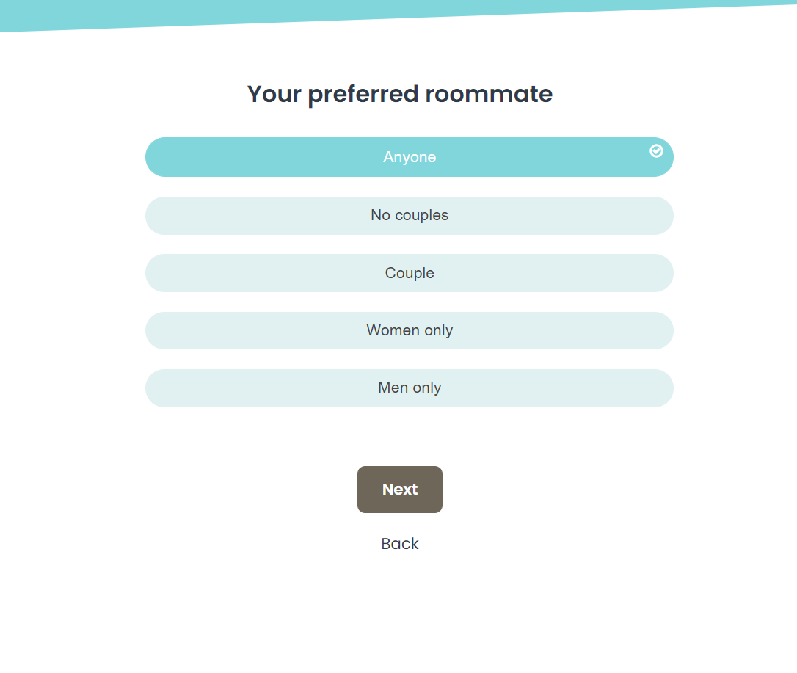
Roommate preference :

Slide 9
